Slide 1

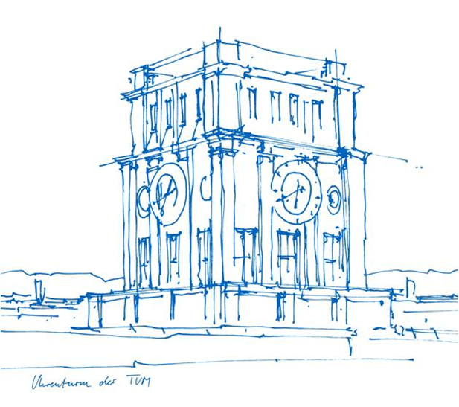
Advanced Topics in Communication Electronics, MSCE, TUM, Winter 2021.
Final Project Presentation
FACE MASK DETECTION
Prepared by:
Abhishek Sengupta , 03736060 , ge79car.sengupta@tum.de
Priyadharshini Ponraj , 03741605 , priya.ponraj@tum.de
Smriti Nandy , 03737798 , ge59wof@mytum.de
Vinay Shankar Kulkarni , 03738026 , vinay.kulkarni@tum.de
DATE: 04.02.2022

Slide 2
Structure
Introduction
Technical Challenges
Detailed Design
Performance Evaluation
Conclusion
Individual team member’s contribution
References
Demo Video
Notes:
Abhishek

Slide 3
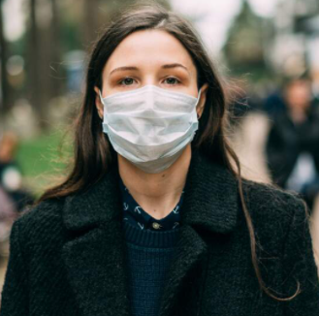
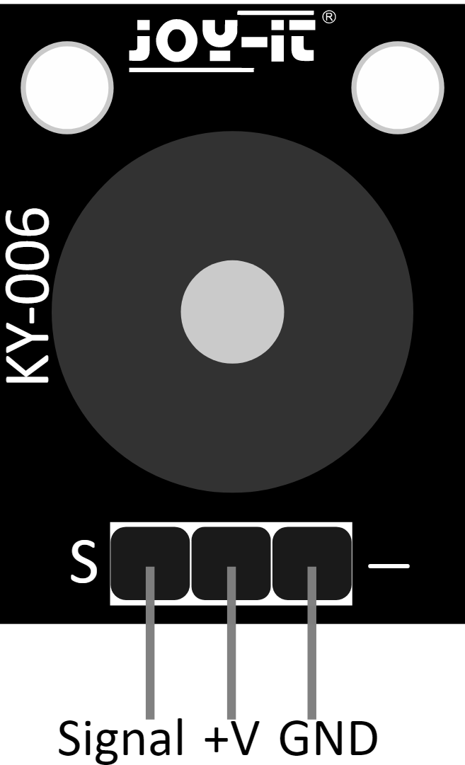
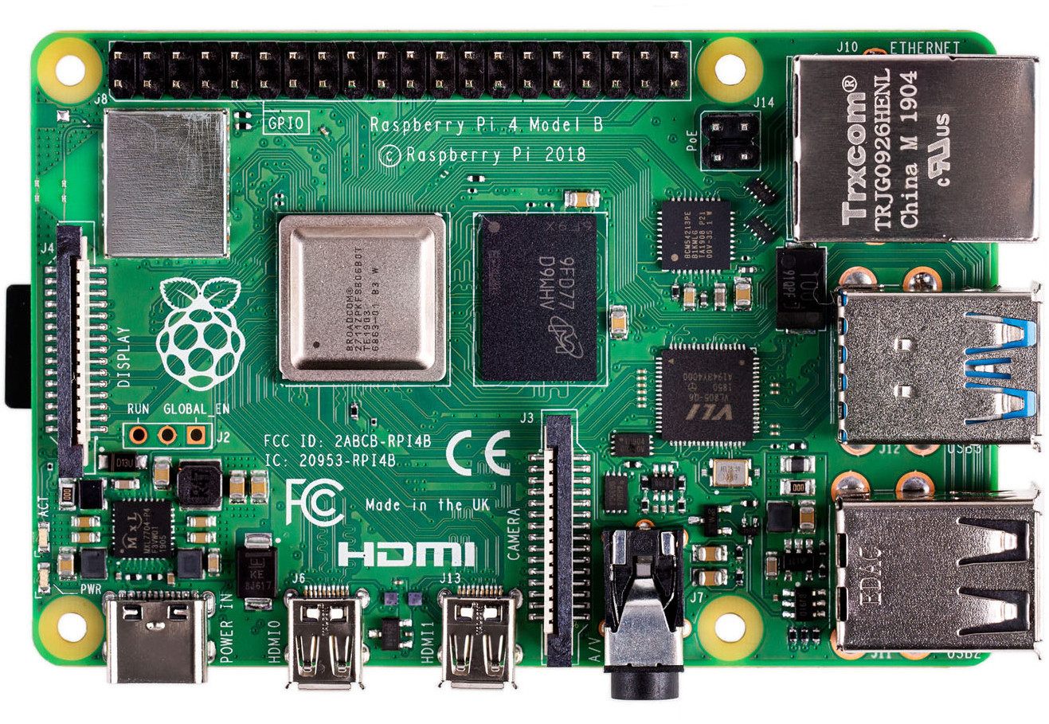
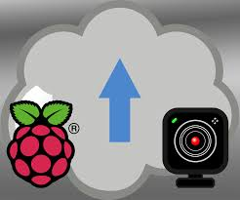
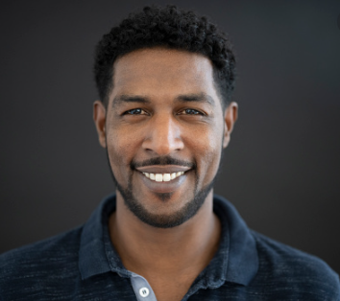
Introduction
Deep Learning based facemask detector
Video captured by camera module is used to determine if the person wears facemask or not
If facemask detected, buzzer does not ring and if not, buzzer rings.
Buzzer Off
Camera Module
Buzzer On
Notes:
Abhishek

Slide 4
Related Background
Convolutional Neural Networks have been used in face recognition tasks.
Squeezenet, Shufflenet, MobileNet are different deep neural network models built previously.
MobileNetV2 is used here because of residual connections and bottlenecks in its architecture.
Notes:
Abhishek

Slide 5
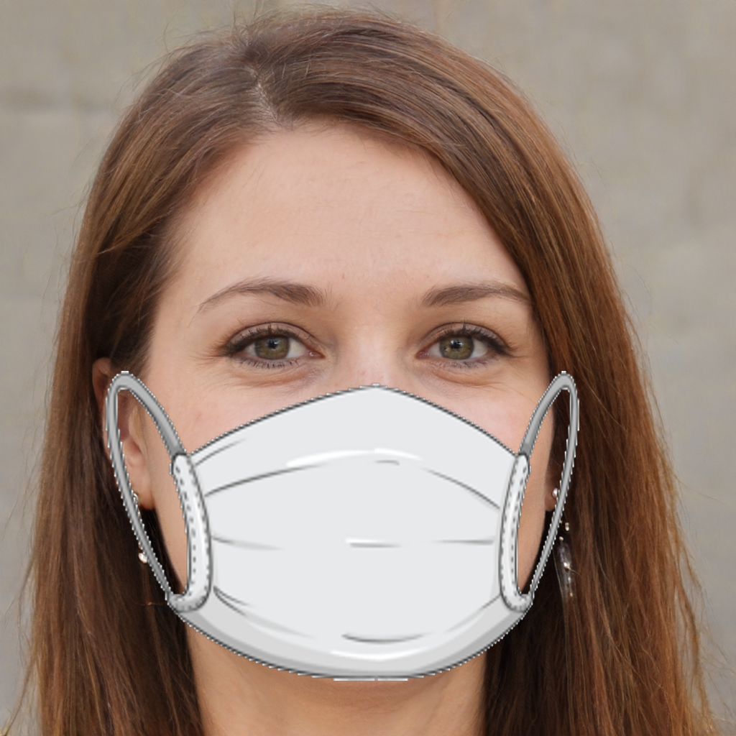
Technical Challenges
Deciding Hardware Board:
Arduino - microcontroller
Raspberry Pi - Microprocessor - Python, 1.2GHz clock
Limitations of Rpi and requirements:
Dependencies and Libraries - Tensorflow
Not suitable for training - Limited processing power
Memory Constraints
Data set:
Size?
Edited Images - Fake face mask. Proceed?
Source: www.kaggle.com
Notes:
Vinay 4min
Other boards, Intels Modivious compute stick,
Jetson nano

Slide 6
Technical Challenges
Implementation methods:
Training on Raspberry Pi - Tensorflow installation problem > .whl is not a supported wheel on this platform
Converting model to tf lite - using Python APIs
Edge Impulse -
TensorFlow ecosystem for training, optimizing, and deploying on edge devices
Cloud training and optimized trained models for deployment. ( foo.eim format)
Issues: Training time exceeded - Optimize Batch Size and epochs
Model Quantization options : Float32(unoptimized) and int8(quantized) - int8 uses 8-bit integers instead of floating-point numbers. Smaller and less accurate, but faster.
https://blog.tensorflow.org/2021/06/how-tensorflow-helps-edge-impulse-make-ml-accessible.html
Notes:
Vinay
Edge devices have limited memory, computing resources, and power. This means that a deep learning network must be optimized for embedded deployment.int8 uses 8-bit integers instead of floating-point numbers and integer math instead of floating-point math, reducing both memory and computing requirements.
https://www.tensorflow.org/lite/performance/post_training_quantization
A Python .whl file is essentially a ZIP (.zip) archive with a specially crafted filename that tells installers what Python versions and platforms the wheel will support.
https://realpython.com/python-wheels/#:~:text=whl%20file%20is%20essentially%20a,a%20type%20of%20built%20distribution.
This is an executable that contains your signal processing and ML code, compiled with optimizations for your processor or GPU (e.g. NEON instructions on ARM cores) plus a very simple IPC layer (over a Unix socket). We do this because your model file is now completely self-contained, it does not depend on anything (except glibc) and thus you don't need specific TensorFlow versions, avoid Python dependency hell, and will never have to worry about why you're not running at full native speed.

Slide 7
Technical Challenges
Bounding boxes:
Boxes in dataset or tensorflow requirement for face detection.
Output - Buzzer only!!
Multiple face detection:
What will be output signal?
Ruled out!
SDK for Live classification:
Python script for classifying Live video using the model.eim file - Implementing camera and buzzer
Notes:
Vinay

Slide 8
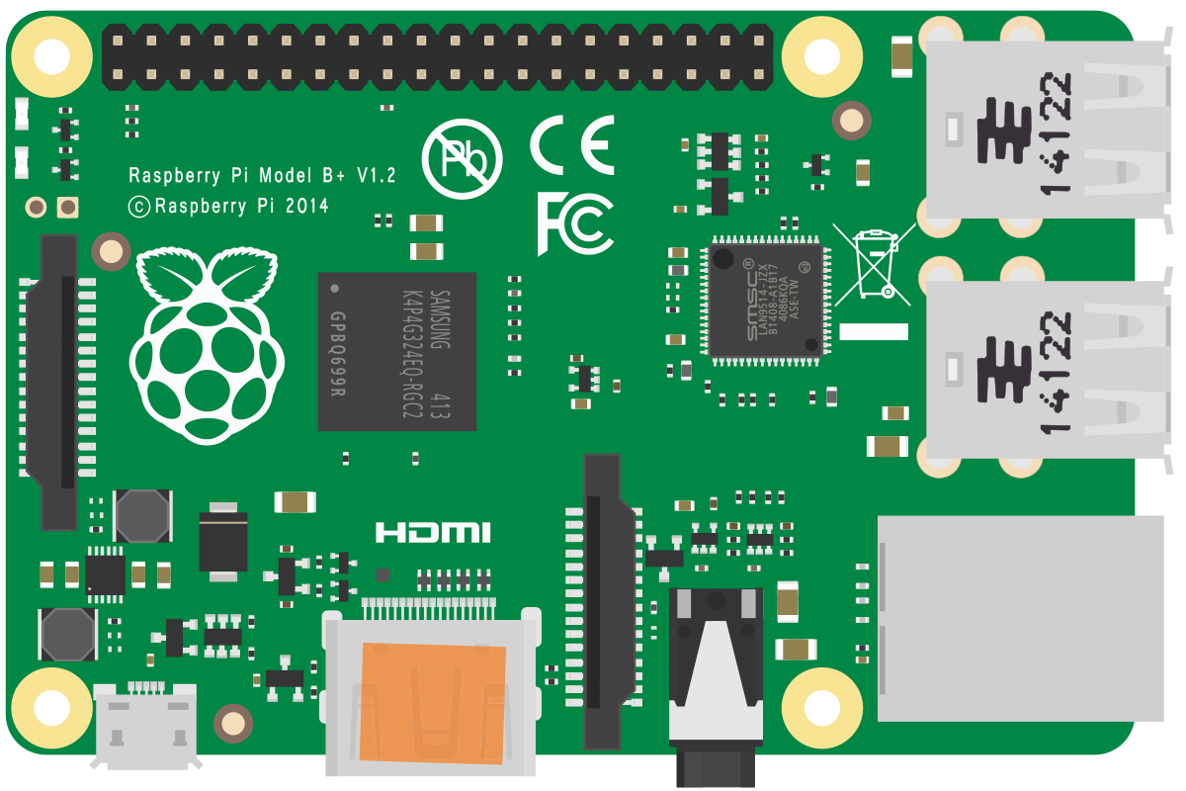
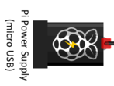
Hardware Setup
Camera
Piezo Buzzer
USB Connection
Raspberry Pi 4 Model B
Fig 1. Hardware Setup
Notes:
Priya 10sec

Slide 9
Hardware Communication
Communication with camera
Communication with buzzer
import cv2
.
.{
.
}
camera = cv2.VideoCapture(port)
if camera.isOpened():
ret = camera.read()
videoCaptureDeviceId = int(port_ids[0])
.
.
.
. }
camera = cv2.VideoCapture(videoCaptureDeviceId)
.
.
.
for res, img in runner.classifier(videoCaptureDeviceId):
import RPi.GPIO as GPIO
GPIO.setmode(GPIO.BCM)
GPActiveBuzzer = 17
{....... }
if ( scr1 >= 0.7 ): print( "Mask Detected" )
elif ( scr2 >= 0.85 ): print( "No mask detected")
GPIO.output(GPActiveBuzzer,GPIO.HIGH)#Buzzer on
time.sleep(0.5) #pause for 0.5 seconds GPIO.output(GPActiveBuzzer,GPIO.LOW)#Buzzer off
Notes:
Priya 1min

Slide 10
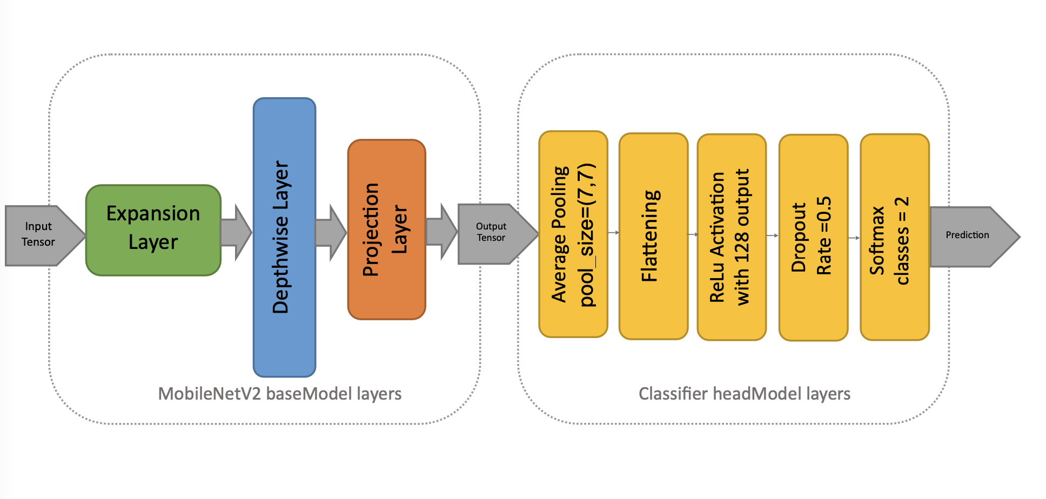
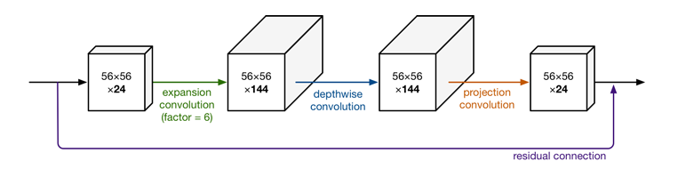
Machine Learning Model
Fig 2 : MobileNetV2 base Model + Classifier Head Model
Fig 3 : Working of the MobileNetV2 base Model [1]
Notes:
Abhishek 2min

Slide 11
Why use the MobileNetV2 Model?
Decompressed data at the input of the depthwise layer, depthwise convolution more effective.
Reduced future computations because of low-dimensional tensor output.
Faster Performance than traditional Machine Learning Models
Notes:
Abhishek

Slide 12
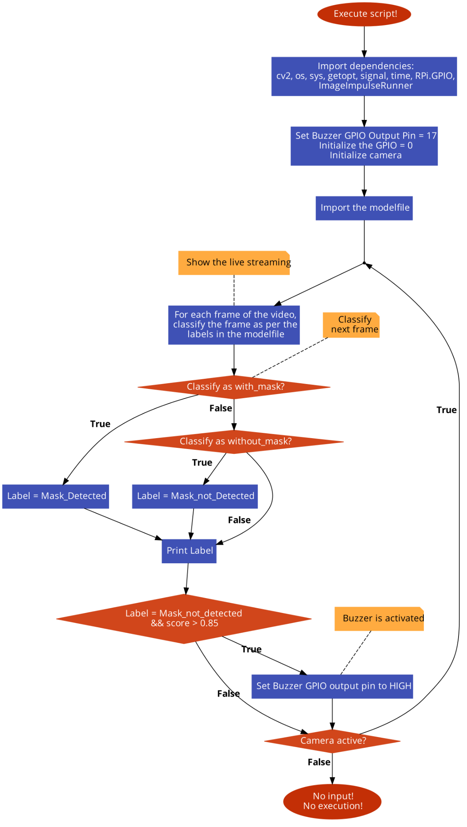
Testing Script
Initialize camera and buzzer GPIO pins
Load the pre-trained model file
Check status of the camera
Classification of frames for the usb camera video
Determine probability of the labels
For label “without_mask” and score > 0.85
Buzzer is activated
Notes:
Smriti 1min

Slide 13
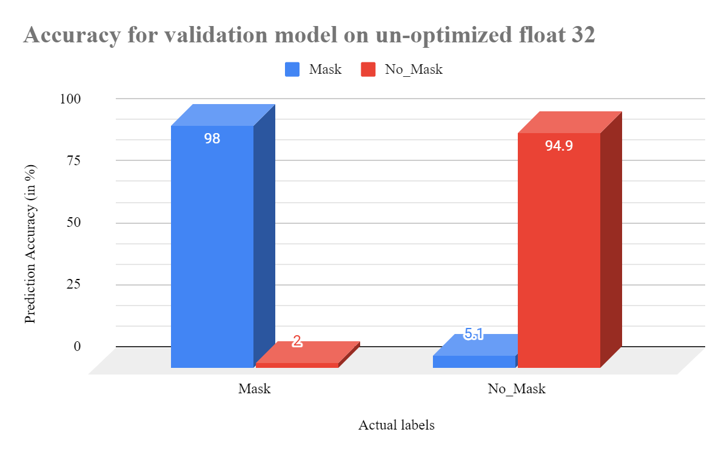
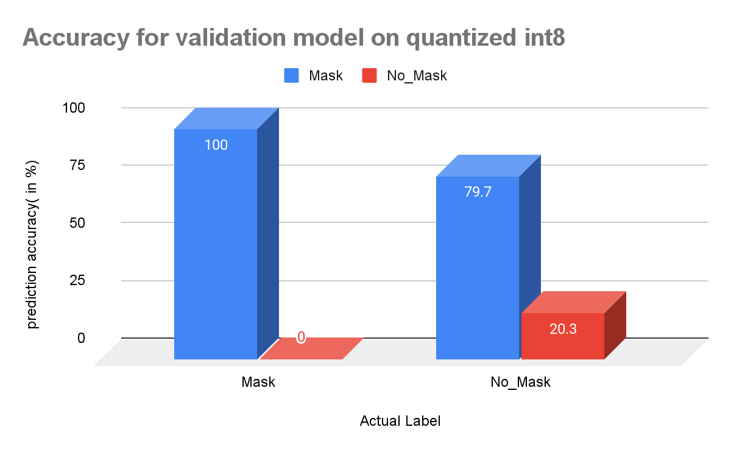
Prediction Accuracy for the model
F1 score is 0.96 for mask prediction and 0.97 for no-mask prediction
Accuracy : 96.3 %
F1 score is 0.68 for mask prediction and 0.34 for no-mask prediction
Accuracy : 56.9%
Notes:
Priya 2min

Slide 14
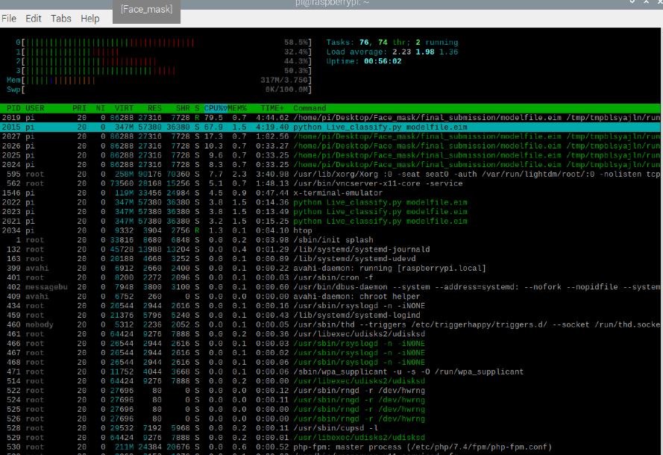
Resource Utilization
26 MB of memory is used by our model file and the entire python script consumes 56 MB of memory.
The total memory consumed by our model is
Approximately 317 MB

Slide 15
Conclusion
Summarizing the project:
COVID-19 Face Mask Detection model is achieved using the MobileNetV2 CNN architecture.
Model is trained with ~4000 images of classes with_mask and without_mask.
Implementation of model on Raspberry Pi 4 with usb webcam and buzzer to indicate the label without_Mask.
Some of the challenges and workarounds:
Installation of python libraries
Use tensorflowLite package
Compress the tensorflow model
Compress the model using fine-tuning
Achieving good accuracy
Unoptimized float32 model
Notes:
Smriti 2min
Summarizing the project:
COVID-19 Face Detection Mask model is achieved using the MobileNetV2 CNN architecture
Model is trained with ~4000 images of classes with_mask and without_mask
Implementation of model on Raspberry Pi 4 with usb webcam and buzzer
Future topics:
Eliminate the classification of the background (without person).
Implement the model on less powerful hardware.
Improve the prediction accuracy with a quantized model.
Use a Binary neural network model to deal with hardware constraints.

Slide 16
Conclusion
Advantage of the system:
Easy deployment using EdgeImpulse platform on embedded system
Fewer computation
Cost efficient system
Future topics:
Improve the prediction accuracy with the quantized model.
Focus on the corner use cases.
Implement a screen with mask detection for real time applications.
Notes:
Benefits:
Fewer computation - later steps have fewer computation

Slide 17
Individual Team Member’s Contribution
TOPICS | CONTRIBUTION
Literature survey | Abhishek Sengupta 25% Priyadarshini Ponraj 25% Smriti Nandy 25% Vinay Shankar Kulkarni 25%
Implement detection model on local system | Abhishek Sengupta 25% Priyadarshini Ponraj 25% Smriti Nandy 25% Vinay Shankar Kulkarni 25%
Generate training model for Raspberry Pi4 | Abhishek Sengupta 30% Priyadarshini Ponraj 20% Smriti Nandy 30% Vinay Shankar Kulkarni 20%
Testing script and Buzzer Implementation for Raspberry Pi4 | Abhishek Sengupta 20% Priyadarshini Ponraj 10% Smriti Nandy 30% Vinay Shankar Kulkarni 40%
Report writing | Abhishek Sengupta 30% Priyadarshini Ponraj 20% Smriti Nandy 25% Vinay Shankar Kulkarni 25%
Notes:
Priya 10sec
Implement detection model on local system - ALL
Generate detection model on Raspberry Pi4
Implement detection model on Raspberry Pi4
Testing script on Raspberry Pi4
Implementing buzzer for Raspberry Pi4
Report writing - ALL
NAMES
Abhishek Sengupta, 03736060
Priyadarshini Ponraj, 03741605
Smriti Nandy, 03737798
Vinay Shankar Kulkarni, 03738026

Slide 18
References
[1] MobileNetV2: https://machinethink.net/blog/mobilenet-v2/
[2] Dataset: https://www.kaggle.com/
[3] Source Code: www.github.com/
[4] RaspberryPi 4: https://www.raspberrypi.com/raspberry-pi-4-model-b/
[5] EdgeImpulse: https://www.edgeimpulse.com/
[6] MobileNetV2 parameters: https://keras.io/api/applications/mobilenet/

Slide 19

Demo Video

Slide 20
Thank You
Questions?

